Slide 1
Build Metabolic Pathways Using COBRApy
Glycolysis Example

Slide 2
Objectives
A brief definition for metabolic pathways
Learn about Metabolite, Model, and Reaction classes in COBRApy.
Learn how to build a metabolic pathway from scratch using three different ways from naïve ones to advanced.
An introduction to Biopython and KEGG database.
How to fetch information from KEGG.

Slide 3

Metabolic Pathway “Important Definitions”
Metabolic Pathway Is any sequence of feasible and observable biochemical reaction steps connecting a specified set of inputs and output metabolites.
01
Input metabolites, also called Substrates, are compounds present in the sterile medium that can be further metabolized by, or directly incorporated into the cell.
02
Output metabolites are compounds produced by the cells that are either excreted to the extracellular medium then they will be called “Metabolic Products” or used in another metabolic pathway.
03
The Pathway Flux is defined as the rate at which input metabolites are processed to form output metabolites.
04

Slide 4
COBRApy Classes
The Model Class is used to incubate a group of chemical reactions, as well to group of pathways then it can hold a whole metabolic network.
The Model Class also has group of functions that do important tasks one of them is the optimization function.
The Reaction Class is used to hold one chemical reaction and references to its metabolites and contains functions manipulating that reaction.
The Metabolite Class represents a metabolic compound and references to reactions it participates in.

Slide 5
Building Metabolic Pathway

Slide 6
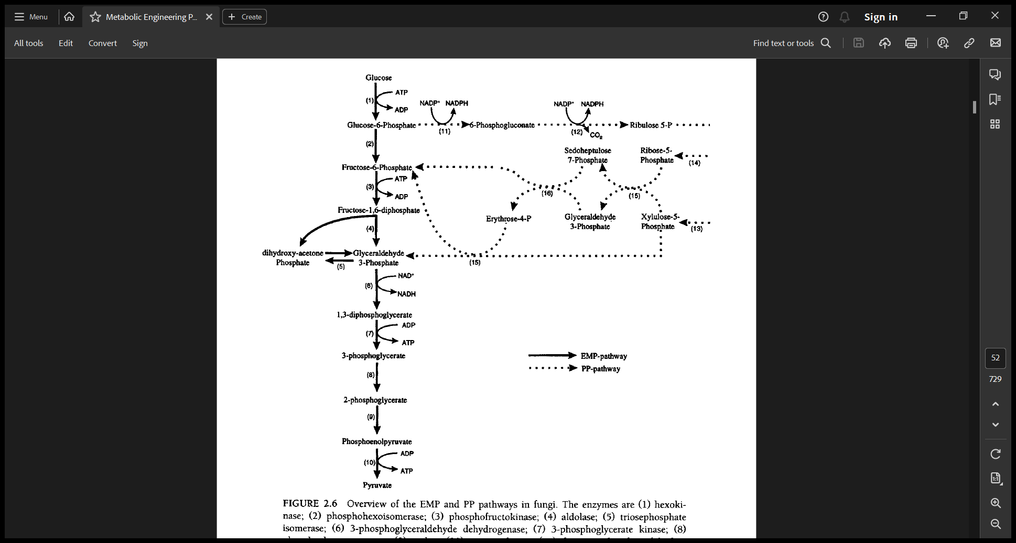
Glycolysis Pathway
Glycolysis is the sum total of all biochemical reactions by which Glucose is converted into Pyruvate.
From the figure there are 10 reactions, which you need to search for in this situation.
The metabolites names are shown but you need to search for other information to build a full metabolite.
You can use images like this to see the flow of reactions, but usually you will search for other information to build this pathway

Slide 7
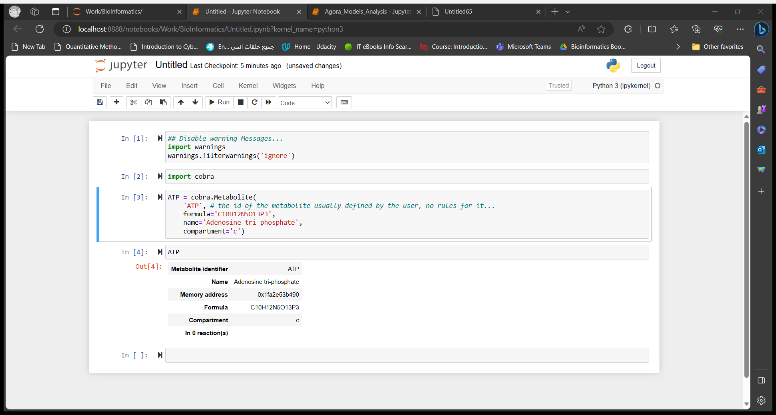
Step1: Collect Your Data.
For metabolites you will search for metabolite name, chemical formula, and its compartment.
The compartment is the location of the metabolite whether in the outer medium [e] or in the cell [c].
An example for building a metabolite:

Slide 8
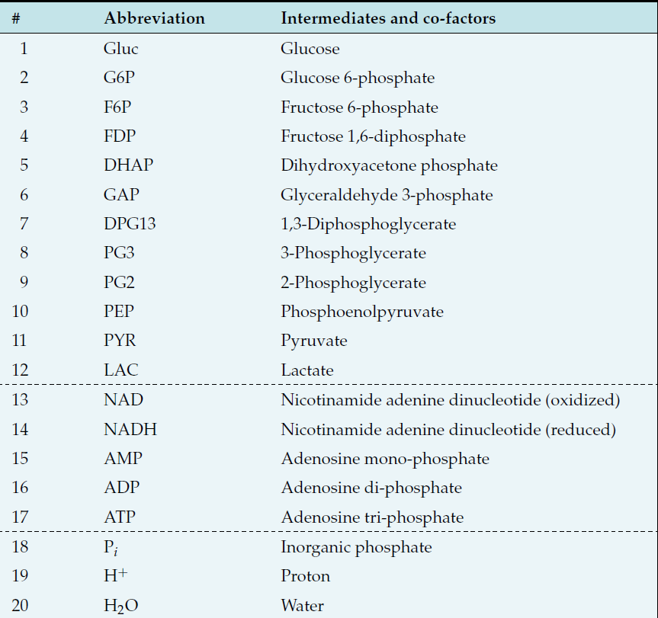
The metabolites for Glycolysis:

Slide 9
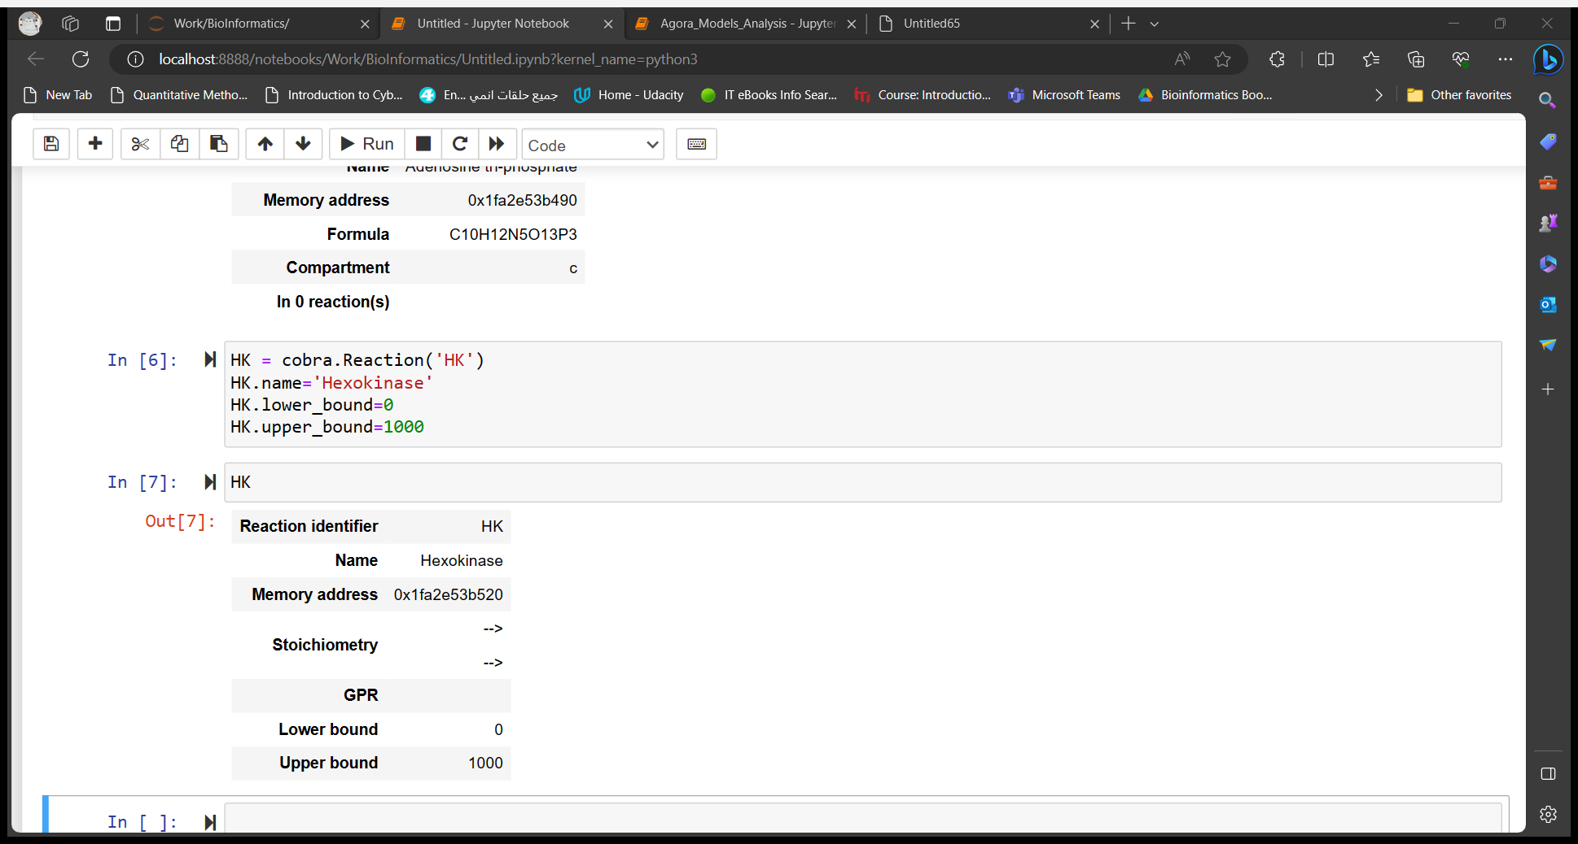
For reactions you need to specify reaction name, its lower and upper bounds and reactants and products and their stoichiometry.
An example for building a reaction:
The addition of metabolites is the last step after the declaration of all metabolites and the reaction holds them..

Slide 10
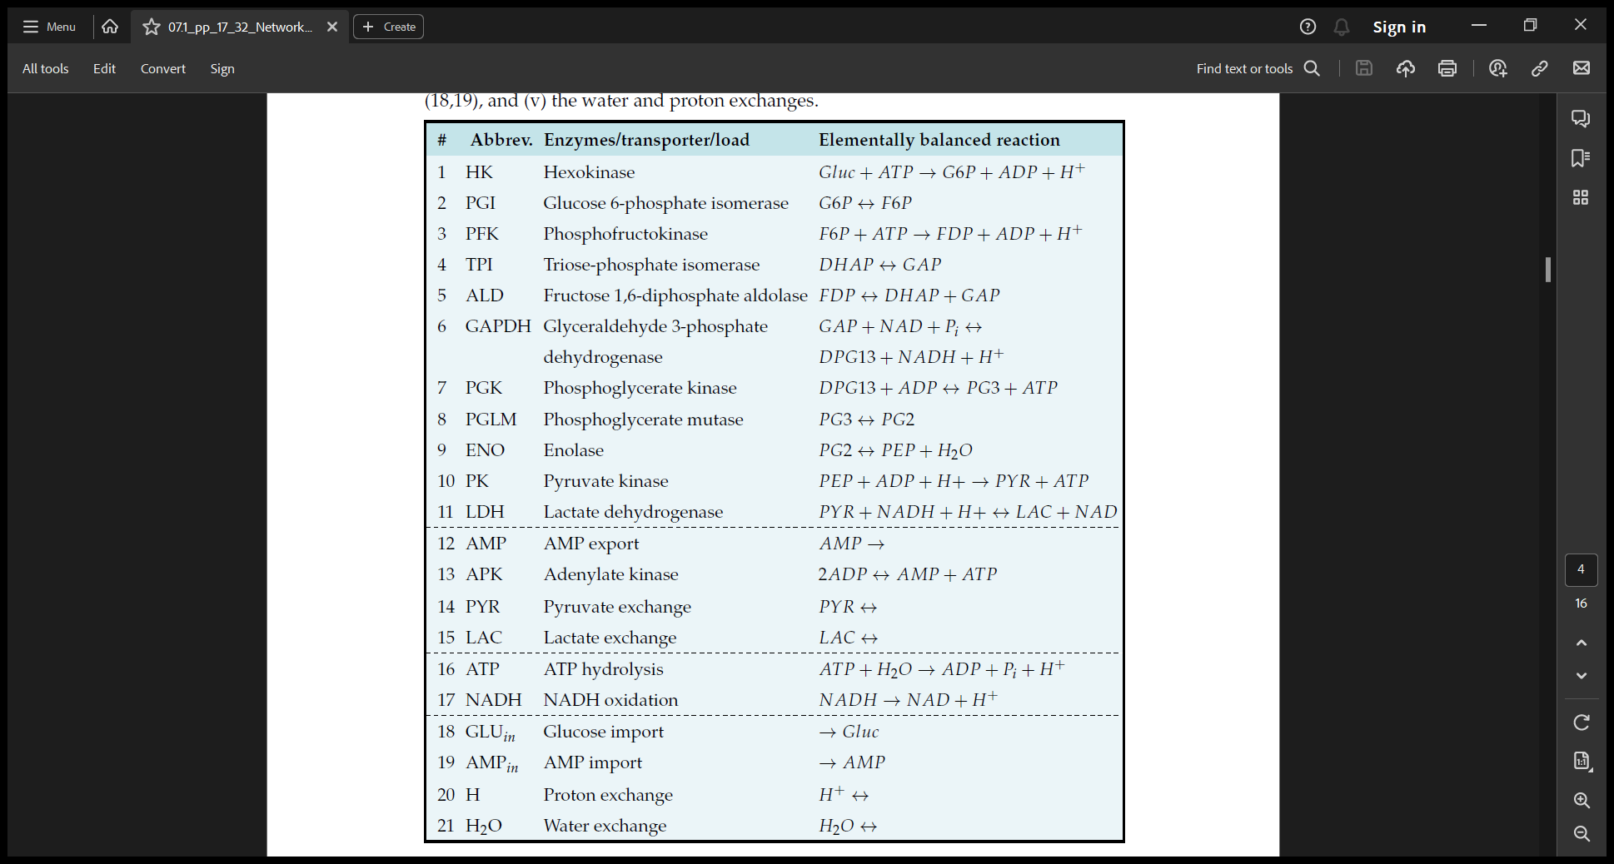
The Reactions for Glycolysis:

Slide 11
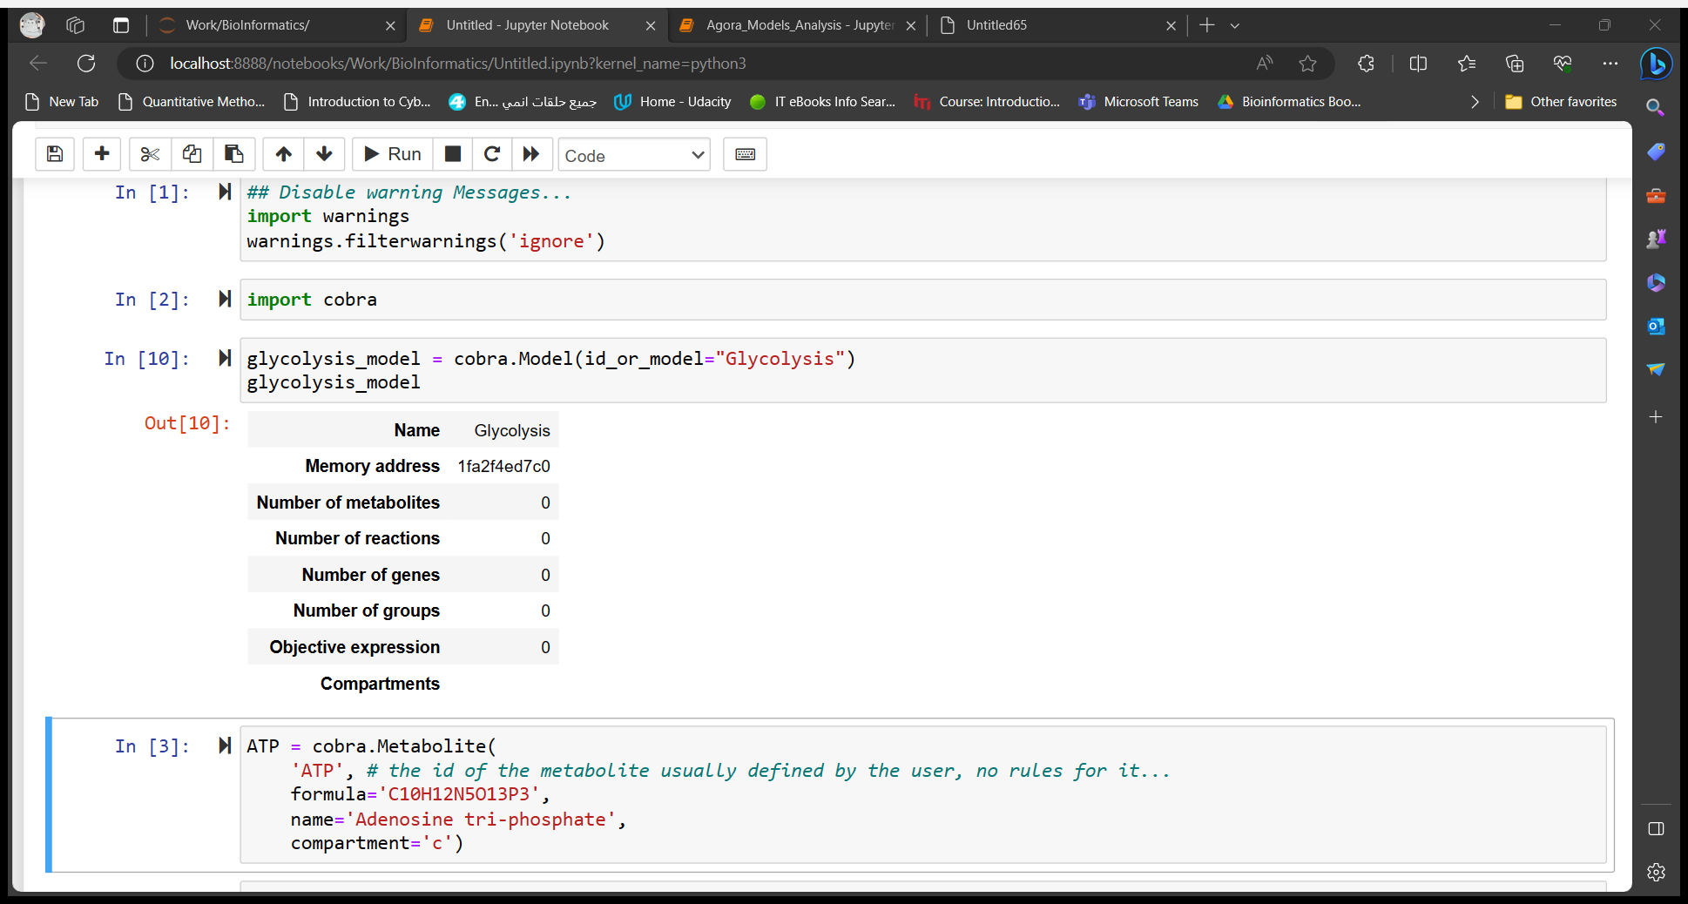
Step2: Declare the Model that will hold all the reactions for Glycolysis.

Slide 12
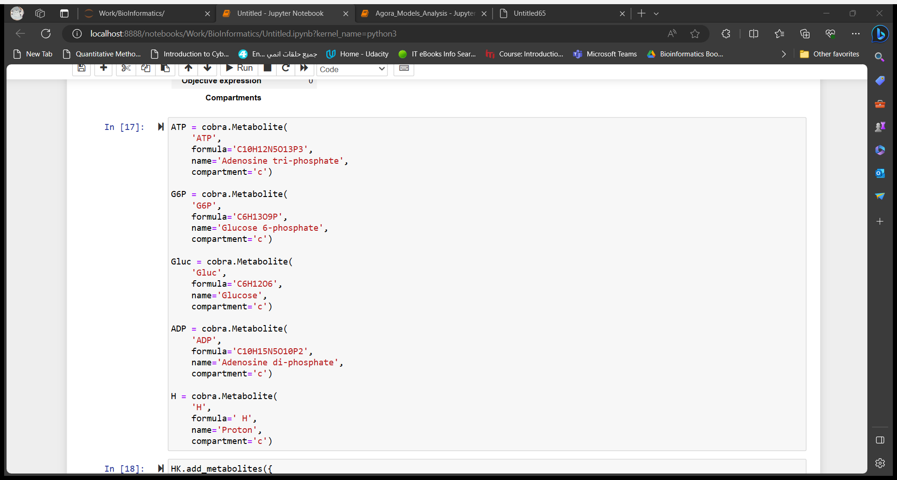
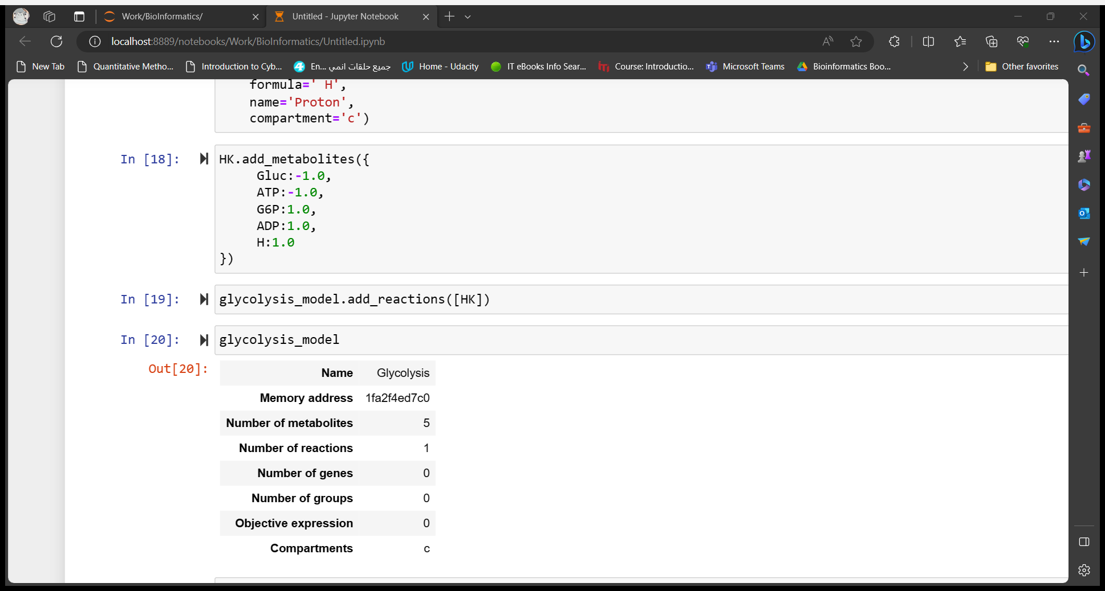
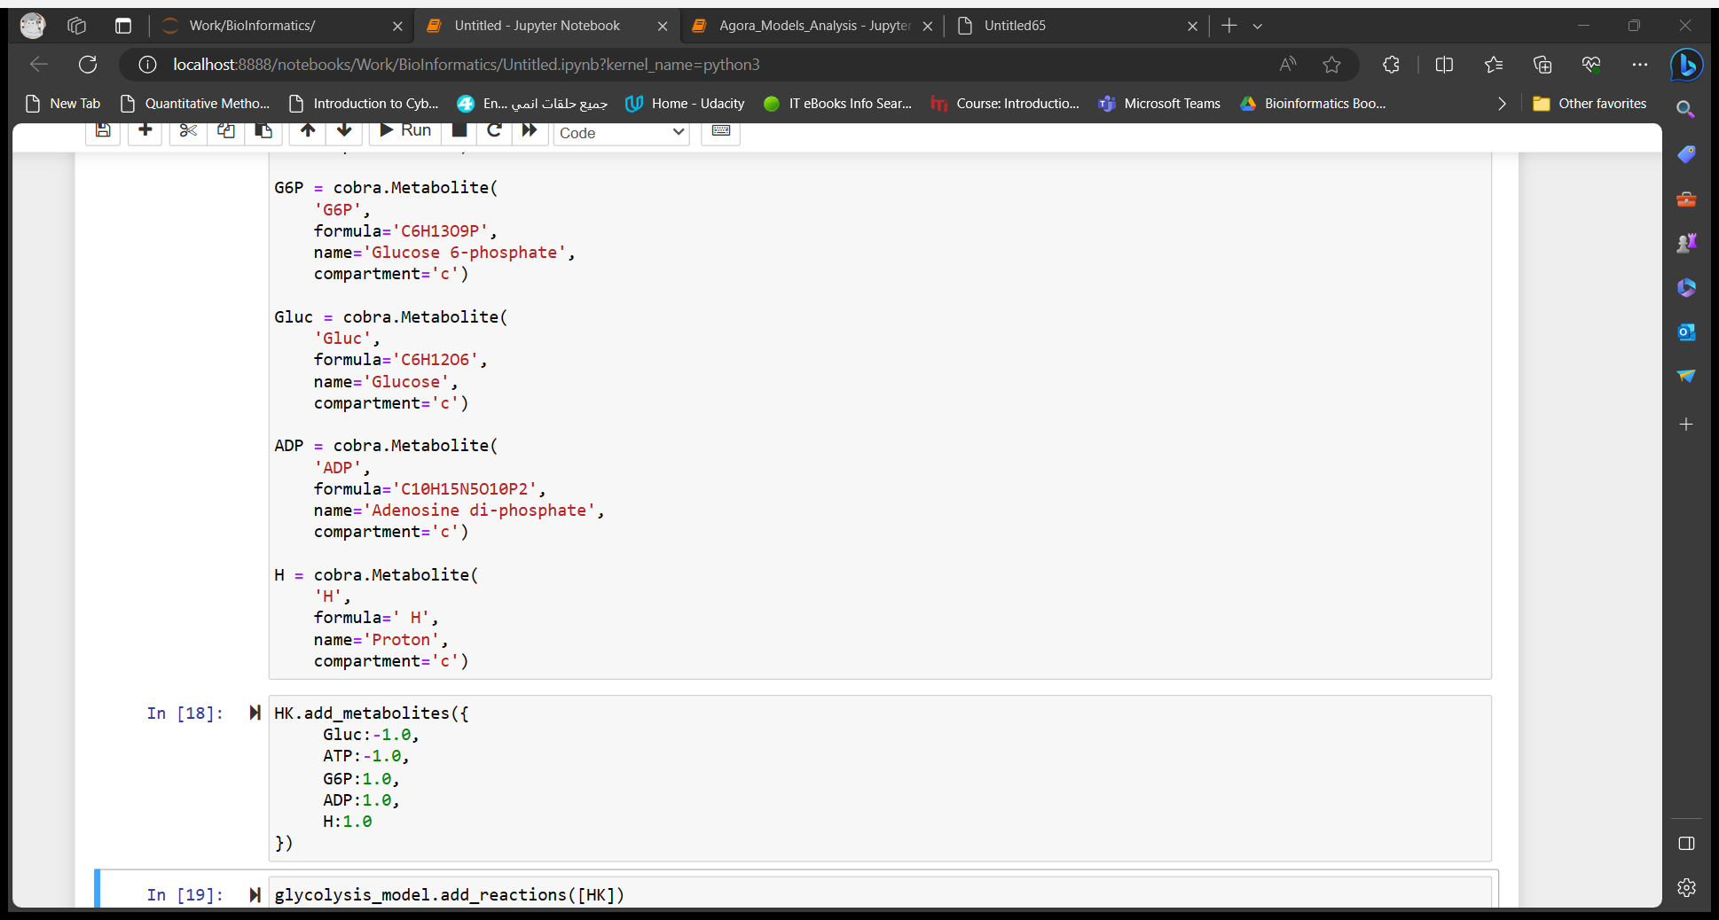
Step3: Filling the Model with reactions.
2: Add metabolites to declared reaction
This procedure is done for all reactions in the pathway.
1: Declaring Metabolites
3: Add the reaction to the model

Slide 13
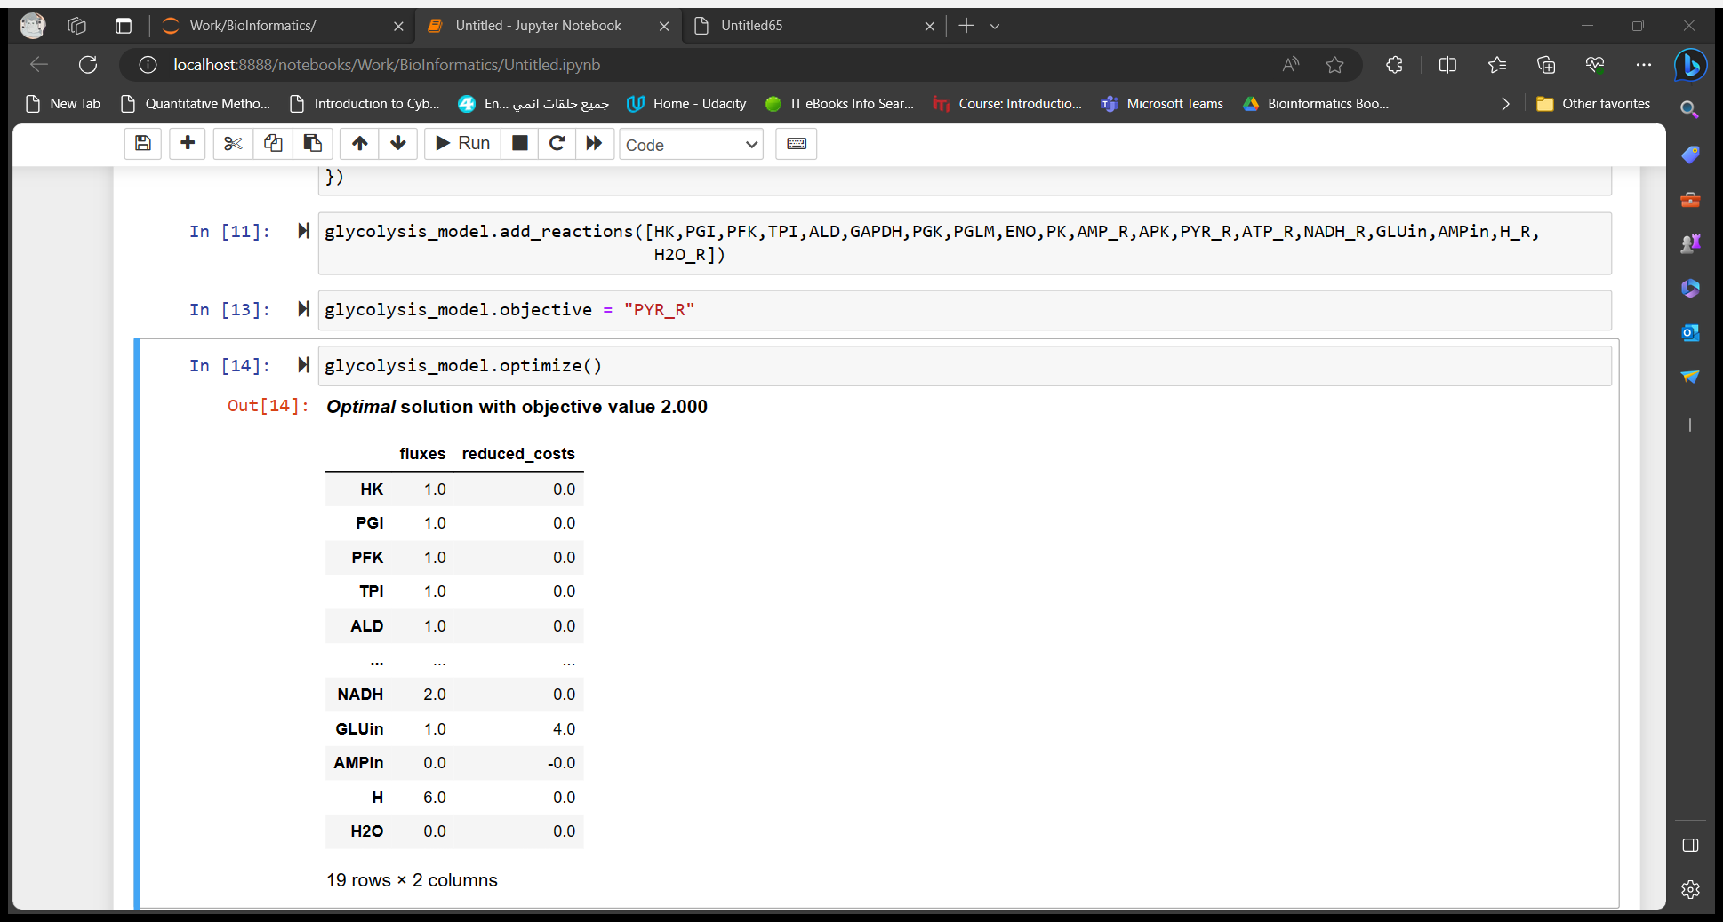
Set The Objective:
After filling all reactions in the model, you choose one reaction as your objective.
This is important to make sure you work is correct.
We choose the Pyruvate Kinase reaction as our objective and after solving the model we got value of 2.
It’s known that one mol of glucose results in 2 mol of pyruvate, thus our work is correct.
The previous procedure is so naïve to use, every time you want to add metabolites and reactions manually.
The Glycolysis is just 19 reactions, but when you’re going to build a full network is it good to use the previous procedure?!

Slide 14
KEGG & Biopython
KEGG is a database resource for understanding high-level functions and utilities of the biological system, such as the cell, the organism and the ecosystem, from molecular-level information, especially large-scale molecular datasets generated by genome sequencing and other high-throughput experimental technologies.
It is a distributed collaborative effort to develop Python libraries and applications which address the needs of current and future work in bioinformatics.
Biopython will be used to fetch information about pathways from KEGG using Bio.REST module.

Slide 15
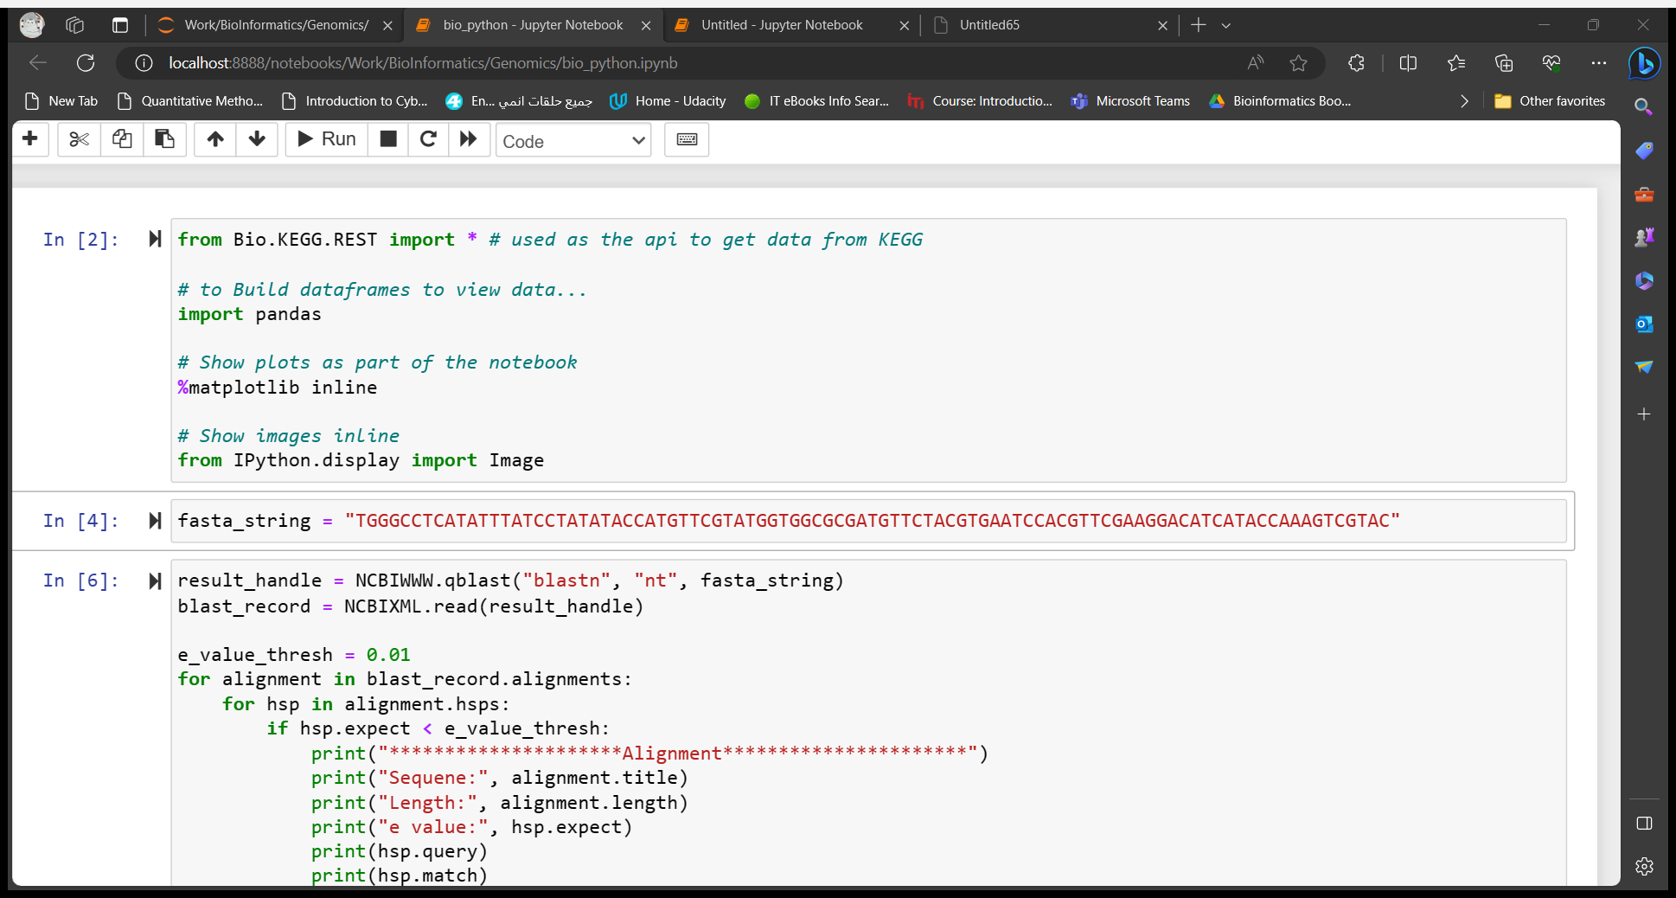
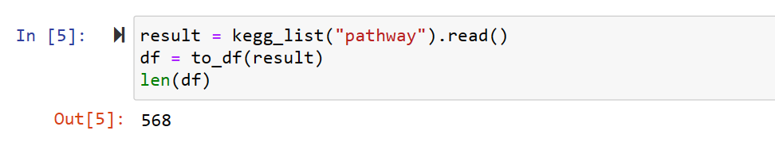
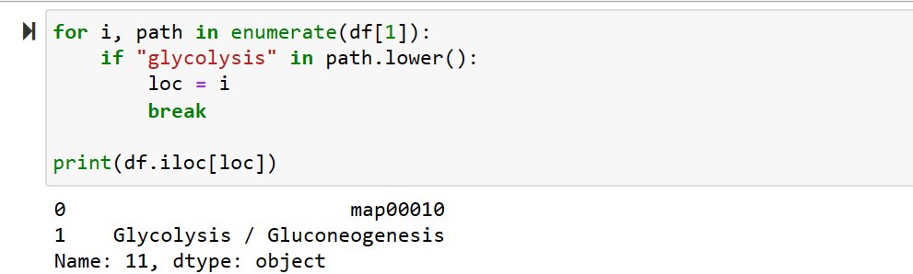
Python Imports:
Get all the pathways in the KEGG:
Get Glycolysis id to search for:
There are 568 pathways in KEGG.
The id used for searching for the pathway

Slide 16
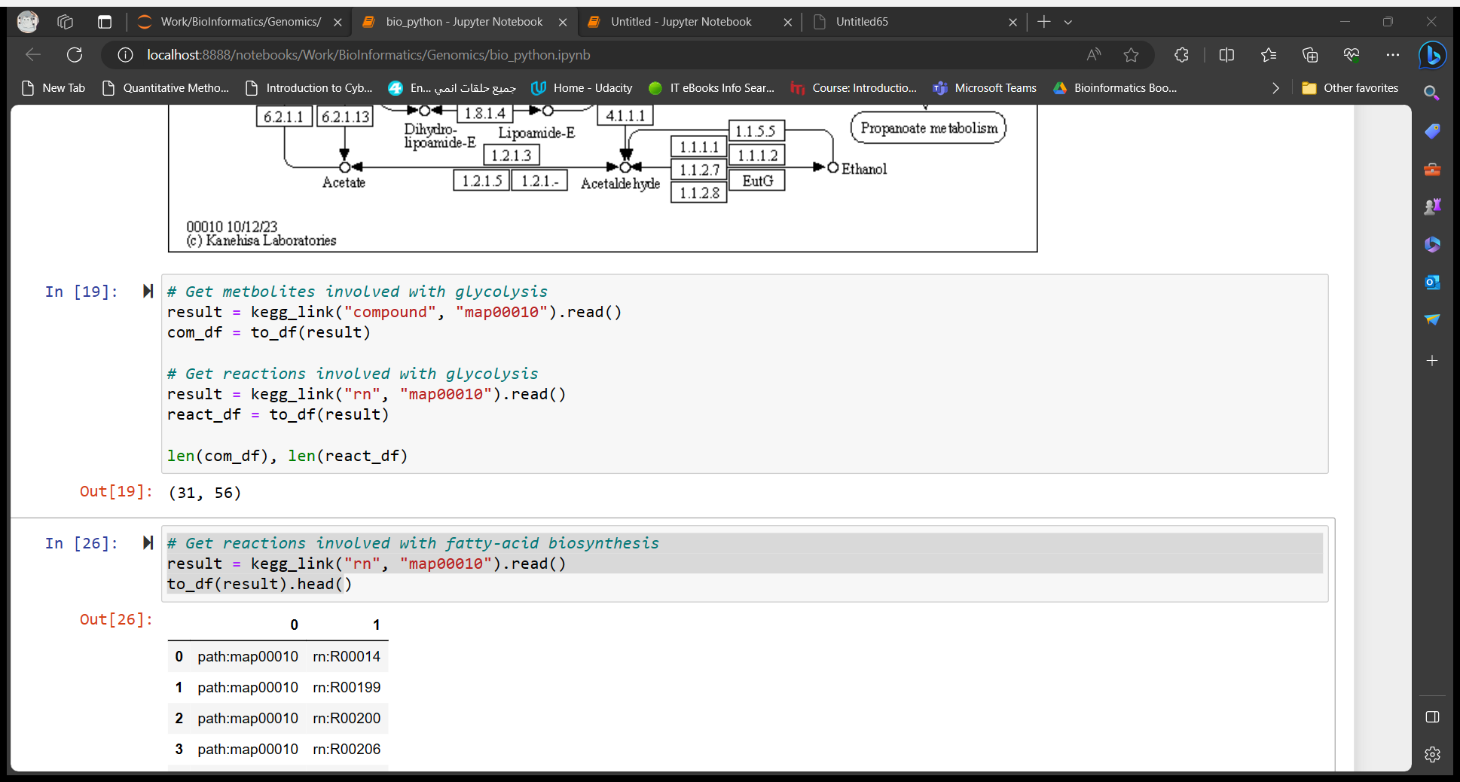
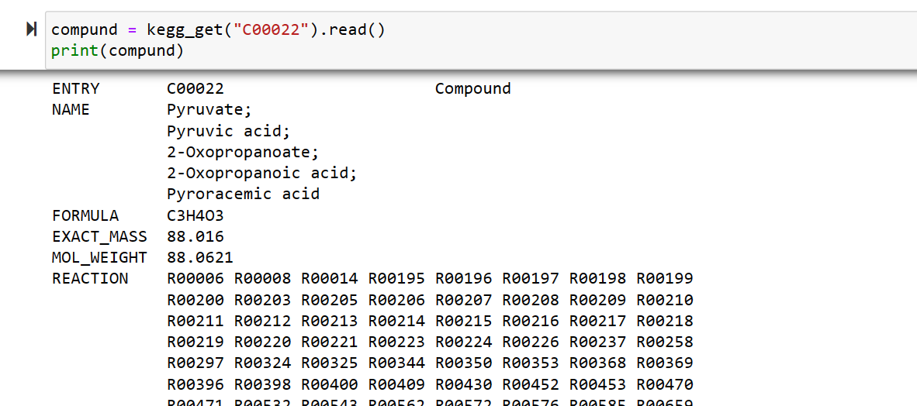
Get all compounds(metabolites) and reactions in the Glycolysis:
Get one compound:
There are 31 metabolites and 56 reactions, from the pathway scrapped from KEGG and that’s right the previous one thinks in Glycolysis as independent pathway and that isn’t right there 5 pathways that share glycolysis in metabolites, you can visit KEGG to see how it represents Glycolysis
id
name
Formula

Slide 17
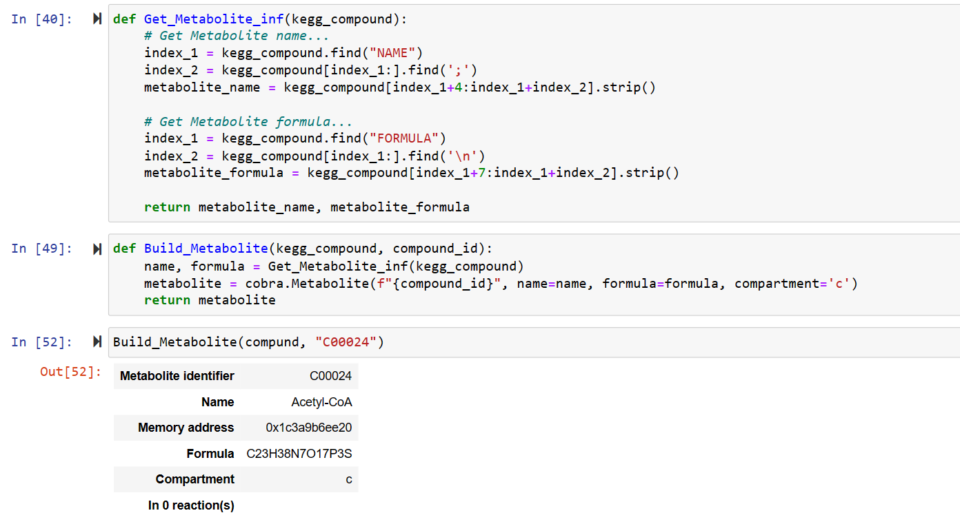
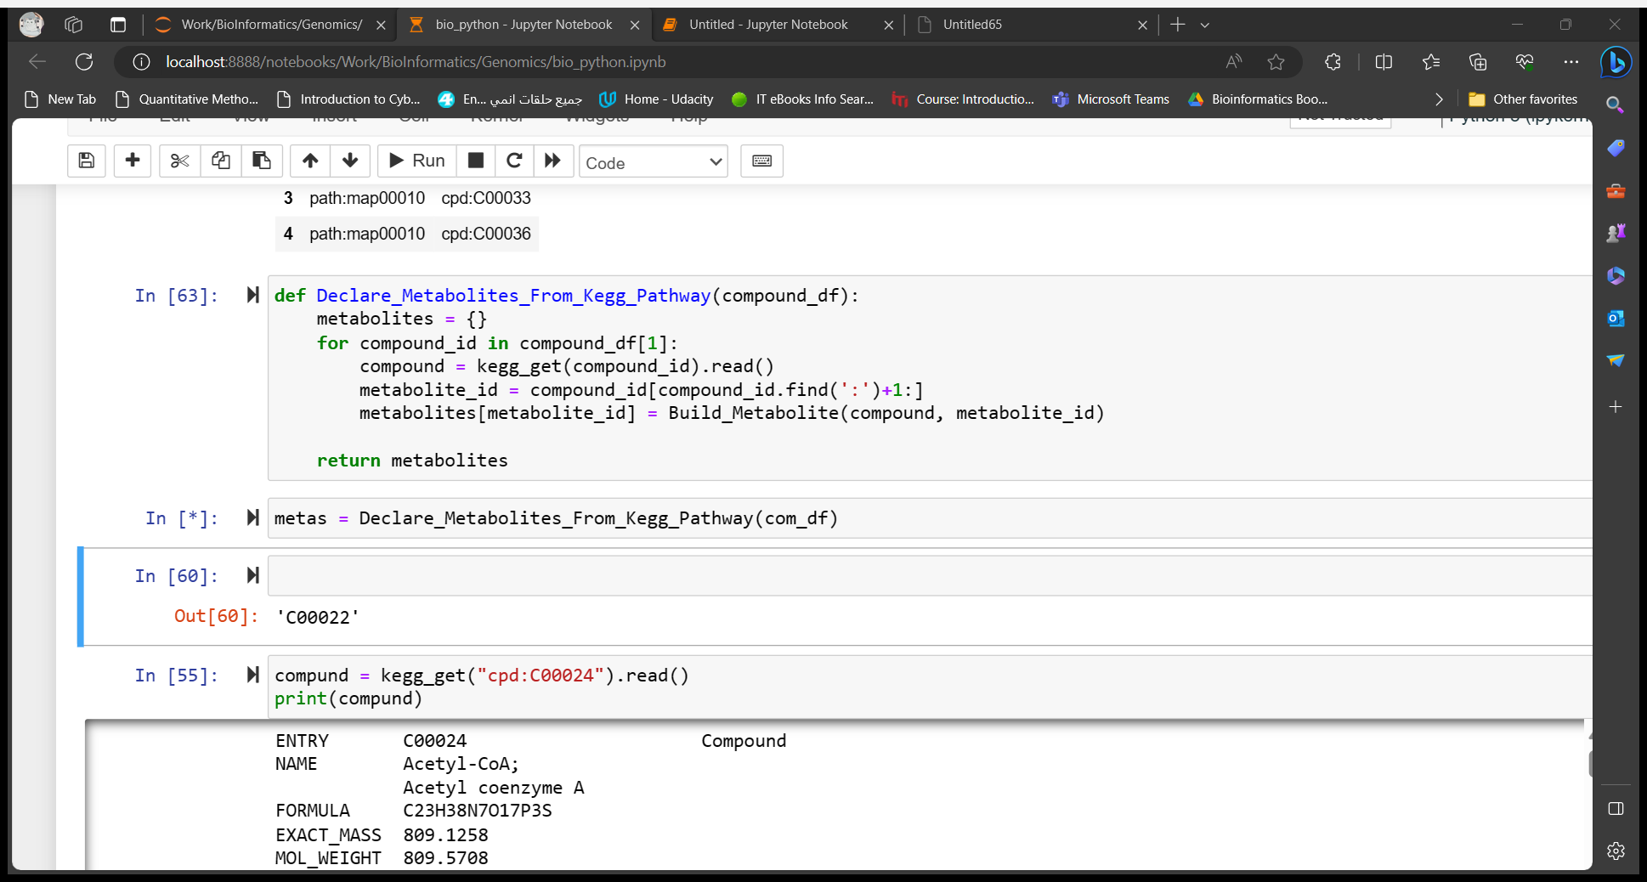
Build COBRA Metabolite from KEGG compound:
This function declares all the metabolites from KEGG pathway.

Slide 18
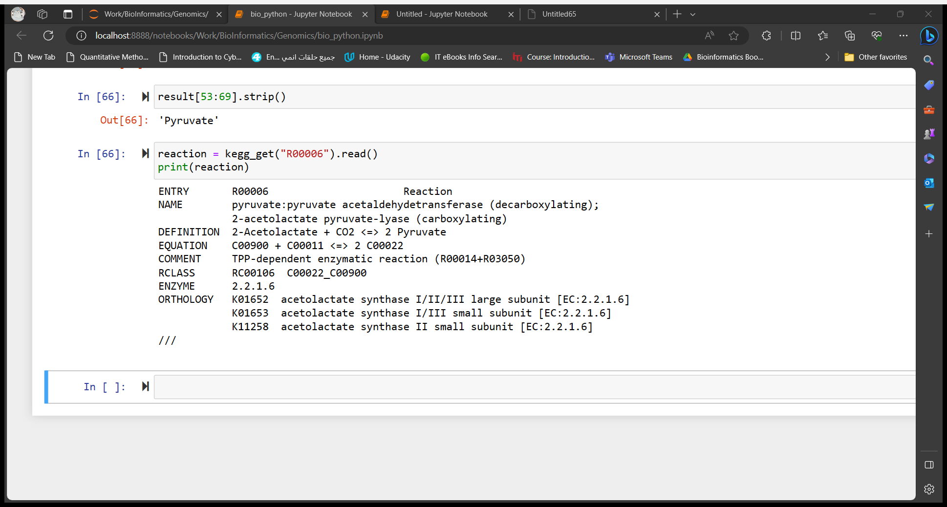
Get one reaction:

Slide 19
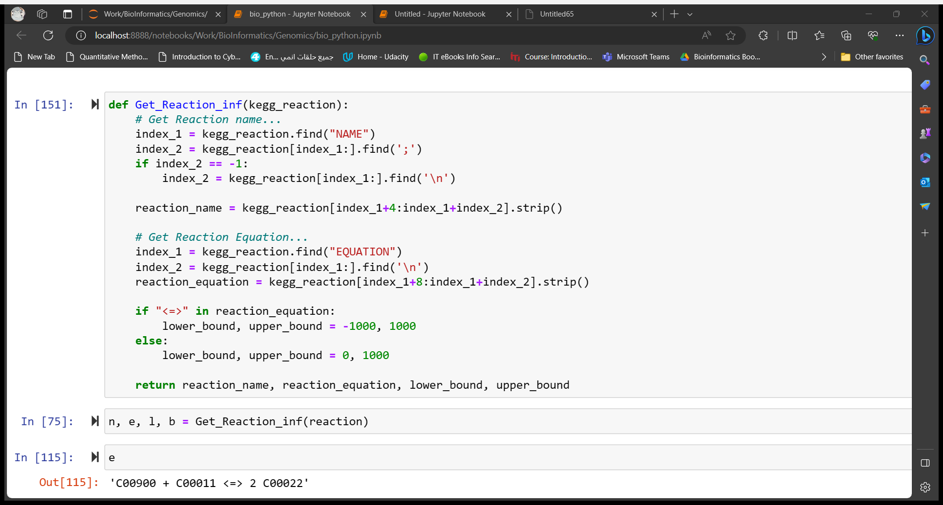
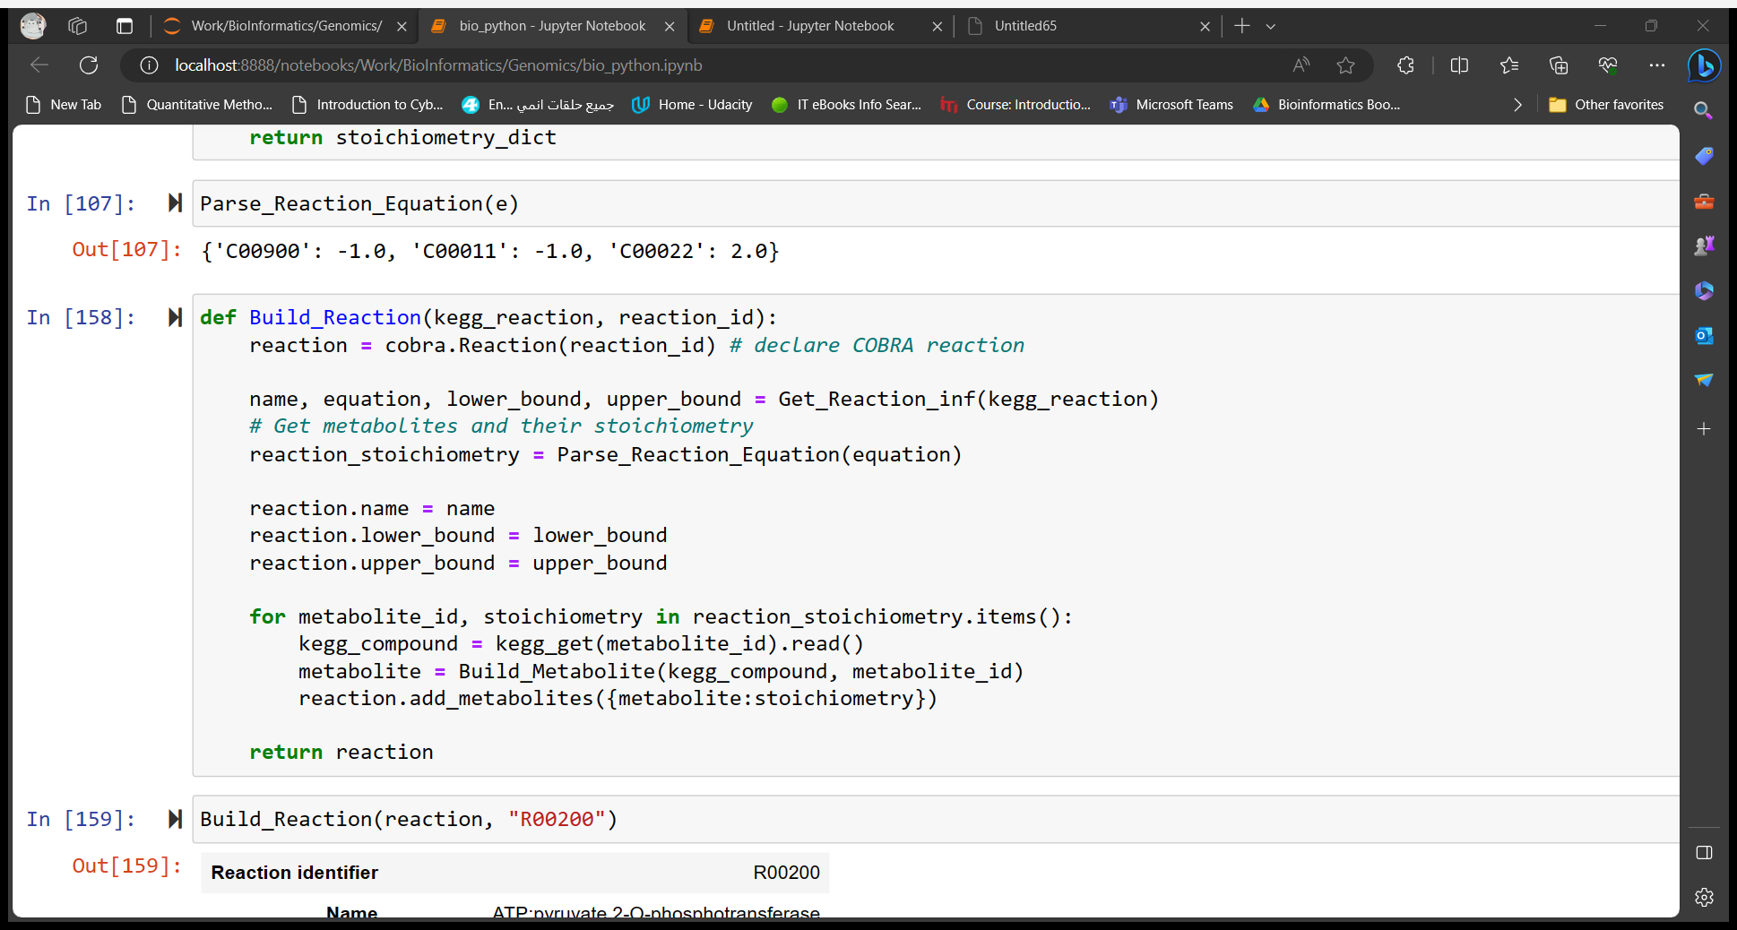
Build Reaction:
This function returns a dictionary that contains compound id as key and its stoichiometry as value

Slide 20
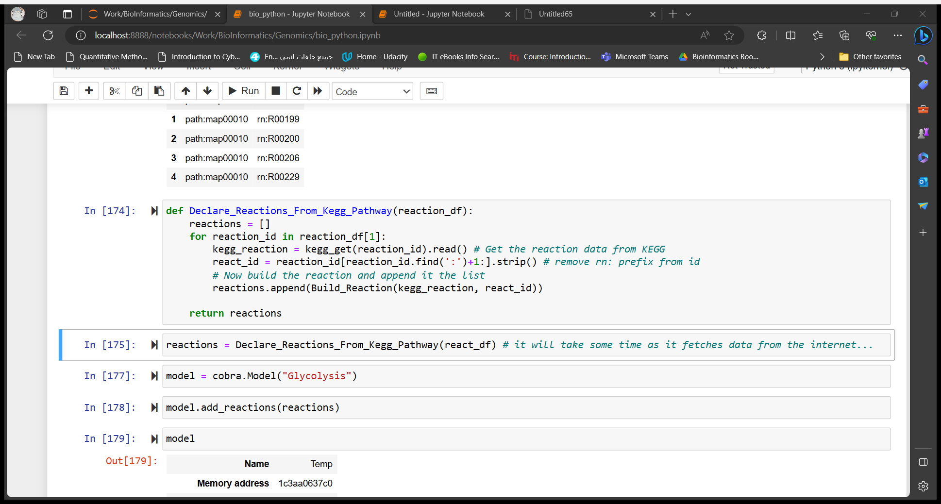
Build Full KEGG Pathway:
Now you could build a full pathway in just few lines, but you should study the pathway in KEGG very well.
Redeclare the lower and upper bounds for reaction to be more realistic.
Add some exchange reactions to differentiate between input and output metabolites.
You may need to do more manipulations to have good insights in the data and re-use it.
This procedure is just an example in how to make use of Biological Databases APIs to help you building your data classes.

Slide 21
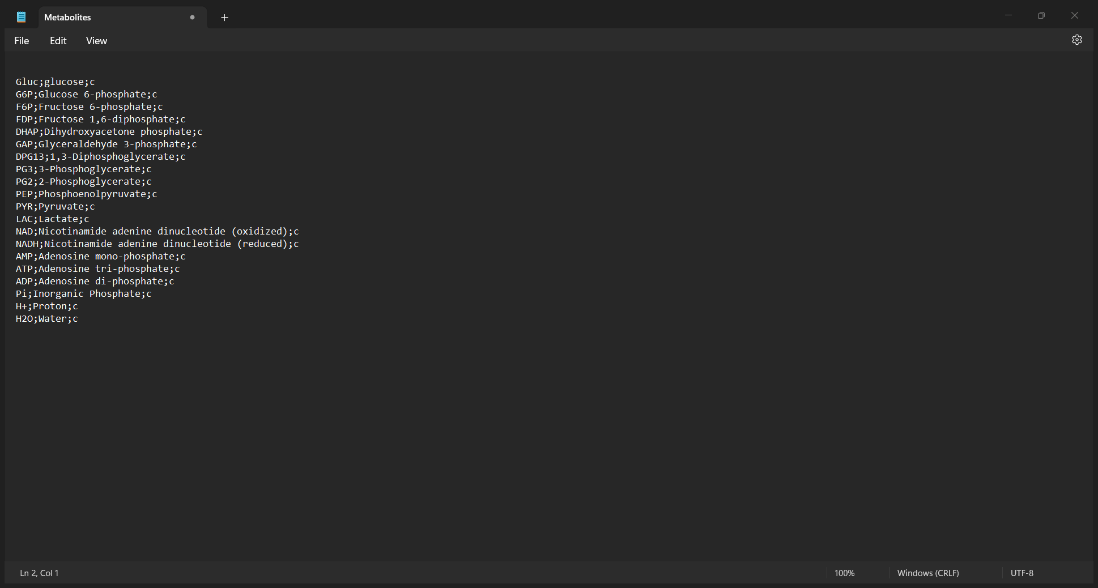
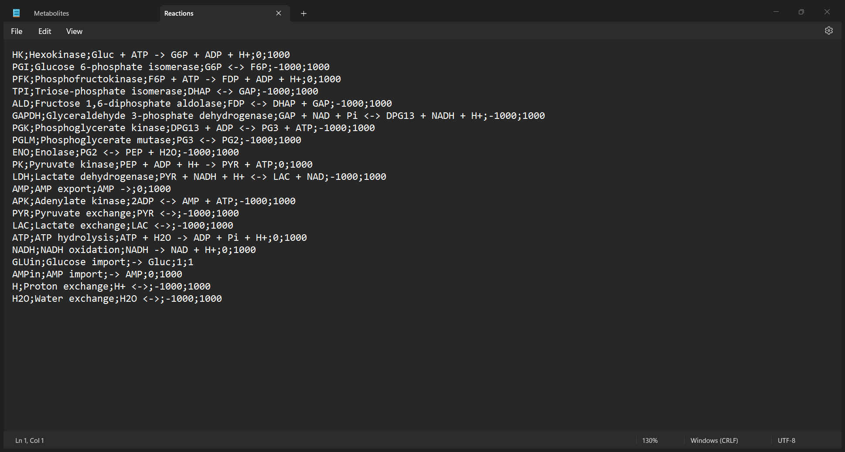
Parse Files
Imagine these two situations:
You don’t trust KEGG pathways, or you see that isn’t meaningful and isn’t easy; you want to search for data by yourself.
A chemist comes to you and gives you the reactions and metabolites he wants.
In two cases you will not use the naïve procedure nor the KEGG API.
So, you collect your data and put them on a file with a specific format and define parsers for it.
The designed parsers are two files the metabolites and reactions with this format:
ABBR;NAME;COMPARTMENT
ABBR;NAME;EQUATION;LOWER;UPPER

Slide 22
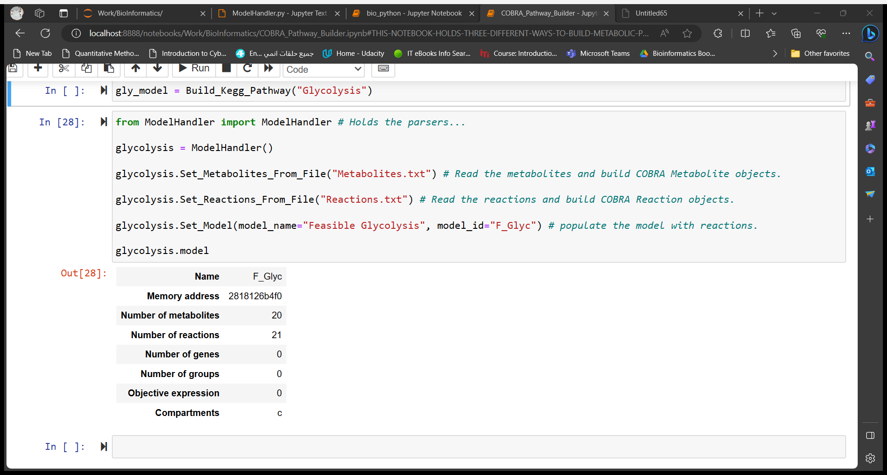
After collecting the data and declare the files:
The implementation of the ModelHandler is provided with the data.
Again, this is not global you can build your own formats and parsers.
The important is that you find way to add the metabolites and reactions automatically and then you could manipulate the model, reactions, and metabolites afterwards to make the results more meaningful.

Slide 23
References
All the data and codes are here:
https://github.com/Al-HassanK/COBRApy-Pathway-Builder/tree/master
https://biopython.org/
https://www.genome.jp/kegg/pathway.html
Books:
Systems Biology Constraint-based Reconstruction and Analysis by Bernhard O. Palsson
Metabolic Engineering Principles And Methodologies by Gregory N. Stephanopoulos, Aristos A. Aristidou, and Jens Nielsen.

Slide 24
THANK YOU

